Slide 1

I Can

Slide 2
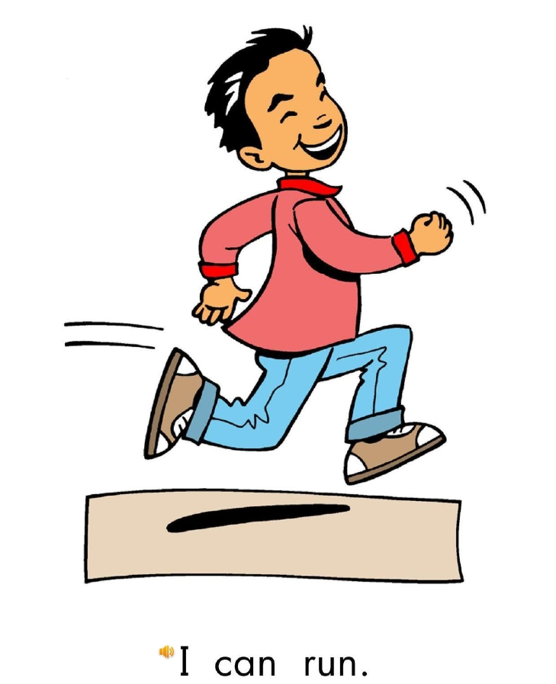
Return

Slide 3
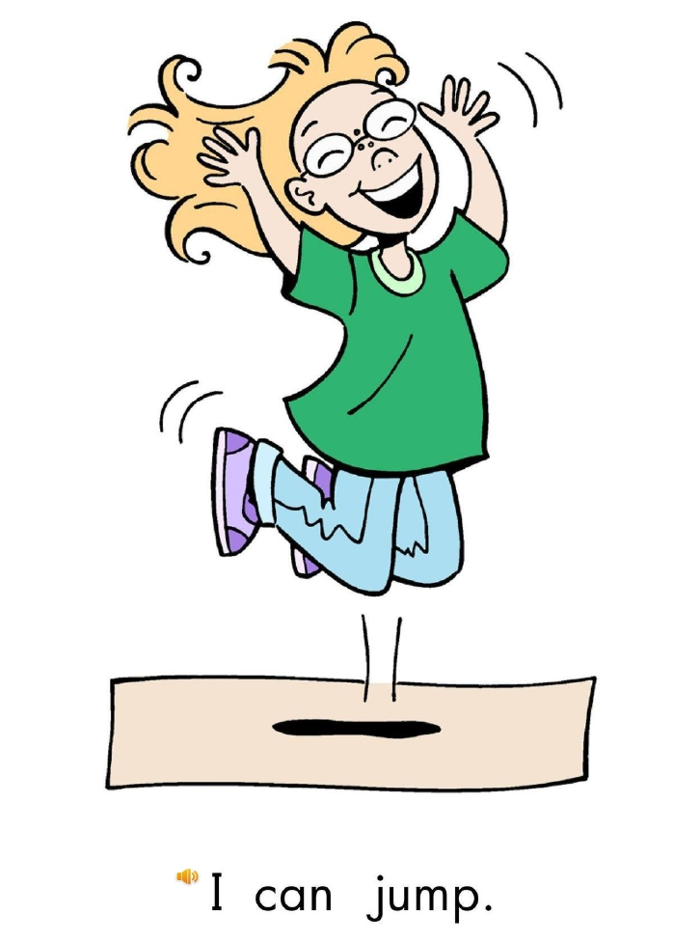
Return

Slide 4
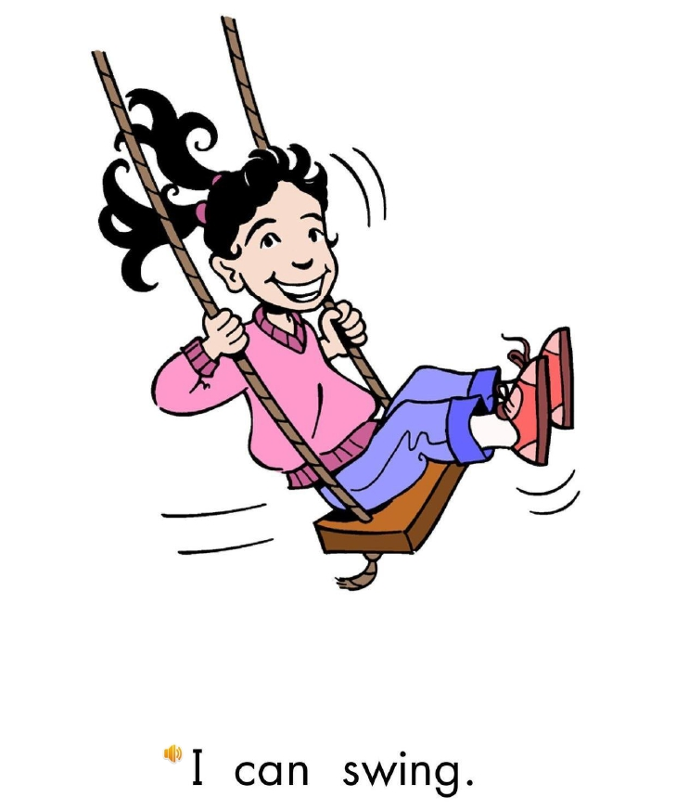
Return

Slide 5
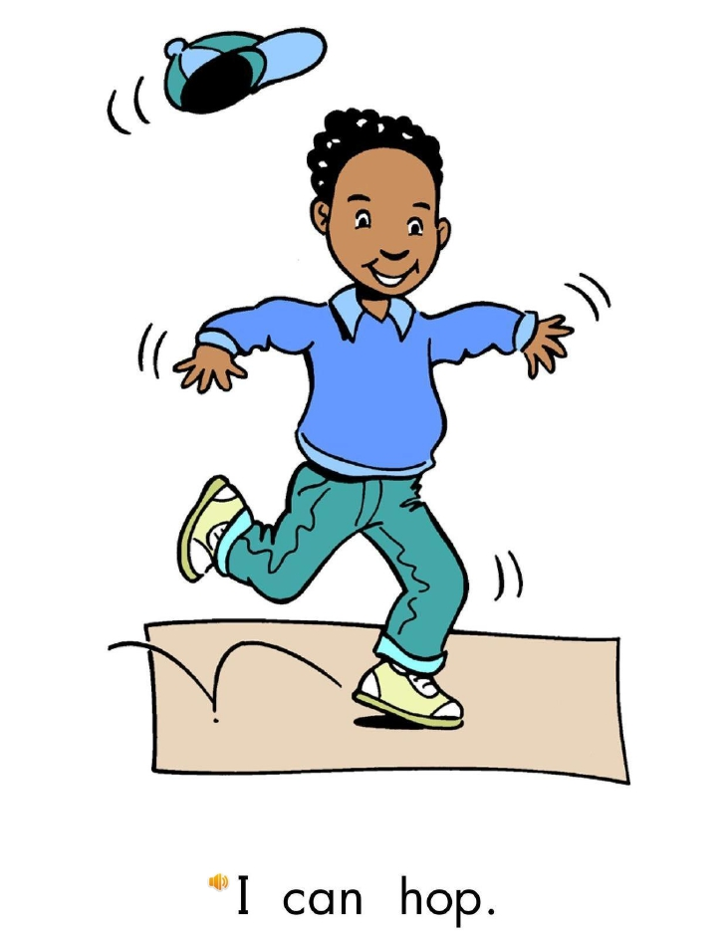
Return

Slide 6
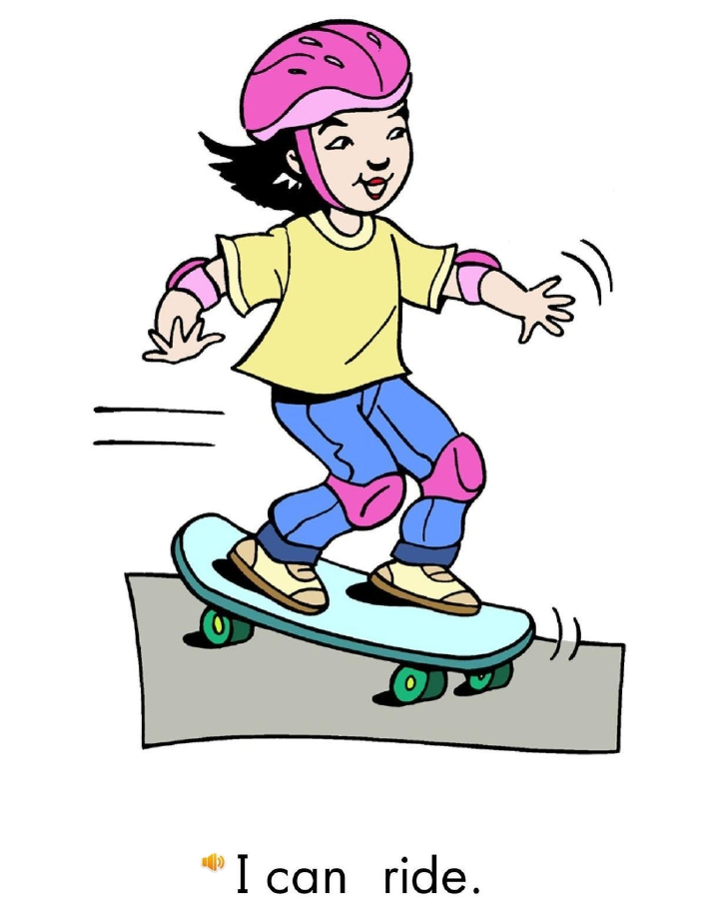
Return

Slide 7
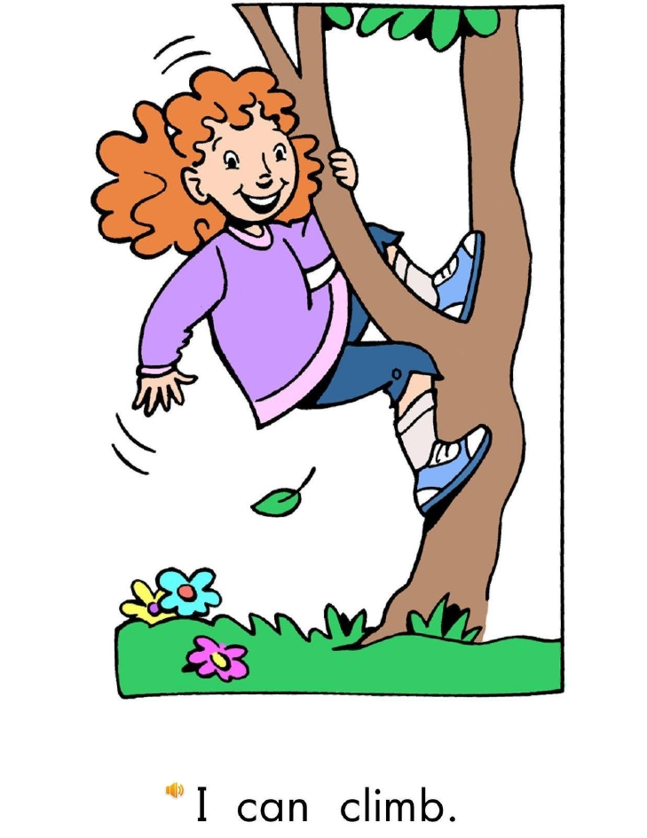
Return

Slide 8
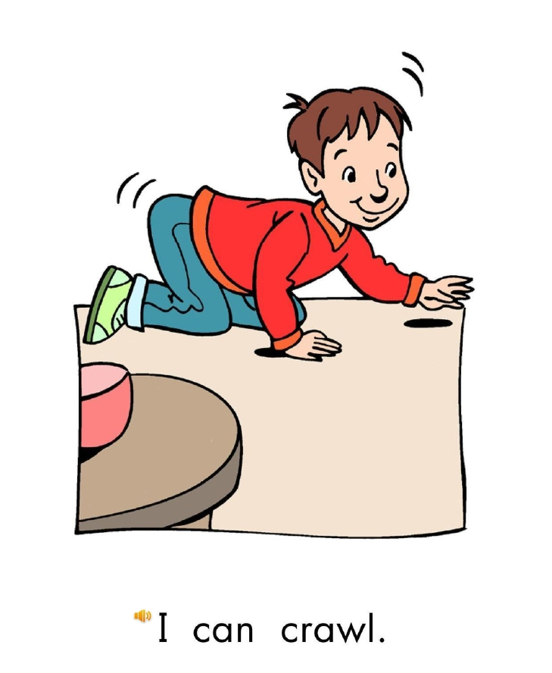
Return

Slide 9
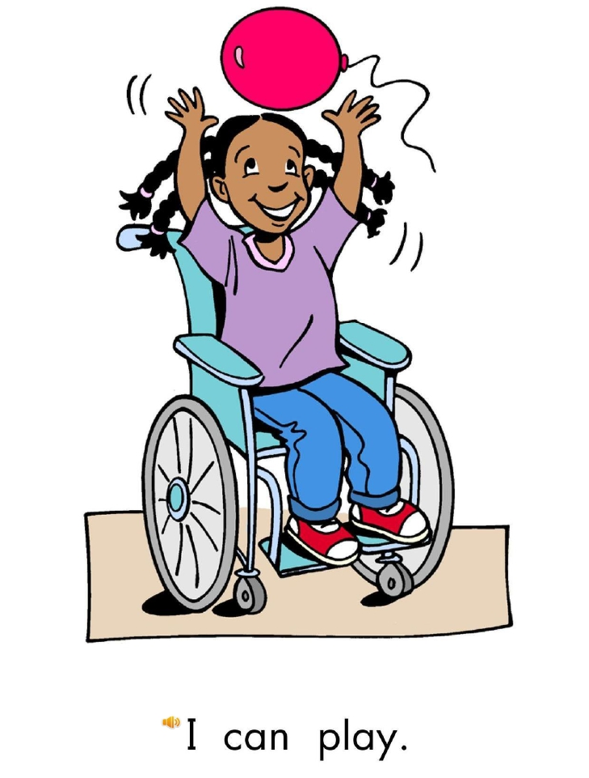
Return

Slide 10
run
jump
hop
swing
ride
climb
crawl
play
Click on the colored buttons to start getting to know the them!

Slide 11


